Slide 1
Accelerating Safe, Effective and Secure (SES) Remote Monitoring and Mobile Health Interoperable Solutions • Addressing the immediate and future needs and gaps exposed by the Pandemic focusing on: in-patient, outpatient, post-acute-care & patient home care scenarios.
Konstantinos Makrodimitris, Ph.D. (US FDA/DHHS liaison)
ISO/TC 215/WG 2 meeting, Systems and Device Interoperability
Monday, May 18, 2020

Slide 2
Disclaimer
Opinions expressed in this presentation are solely my own and do not express the views or opinions of my employer.

Slide 3
COVID-19 pandemic and need for remote monitoring and mobile health solutions
Current COVID-19 pandemic created enormous need to allow patients and clinicians to communicate and report in a more flexible and virtual way
Remote patient monitoring allows health providers to monitor disease and symptom progression remotely and interact with patients virtually
Telehealth (telemedicine, teledentistry etc.) can be facilitated with remote patient monitoring and mobile health interoperable solutions

Slide 4
COVID-19 pandemic and need for remote monitoring and mobile health solutions
Many government and agencies around the world encourage and provide guidance/policies to allow clinicians, dentists and patients to adopt telehealth virtual solutions and practices
US FDA: Enforcement Policy During the Coronavirus Disease 2019 (COVID-19) Public Health Emergency For:
Non-Invasive Remote Monitoring Devices Used to Support Patient
Digital Health Devices For Treating Psychiatric Disorders
Remote Ophthalmic Assessment and Monitoring Devices
Non-Invasive Fetal and Maternal Monitoring Devices

Slide 5
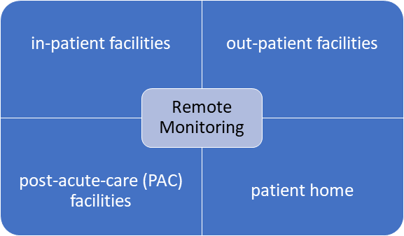
Telehealth solutions: User Narratives and Use Cases
Need to identify a number of User Narratives decomposed into Use Cases for the purpose of extracting key interoperability requirements.
User Narratives will include:
Home based remote surveillance
Surveillance of a patient with a chronic disease
Home based remote clinician consult
Acquisition of vitals for remote consult
Long-term acute care monitoring
Acquisition of continuous patient vitals for remote consult and monitoring
In-Hospital patient monitoring
Integration of device data acquisition and control at the patient bedside
Courtesy Gora Datta

Slide 6
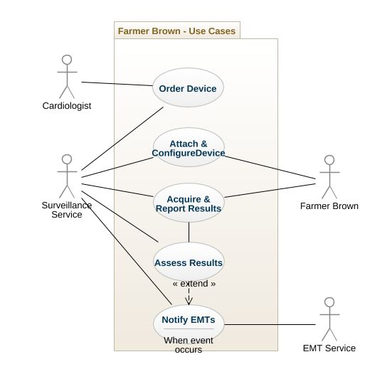
Telehealth solutions: User Narratives and Use Cases
Example User Narrative – Remote Surveillance
Mr. Brown, a farmer in Nebraska, has a history of fainting with no specific diagnosis. After examination by his cardiologist he was prescribed a portable device which collects and transmits ECG (2-lead), blood pressure, and also detects falls. The solution communicates with a central command center which dispatches to the closest EMT.
Courtesy Ken Fuchs

Slide 7
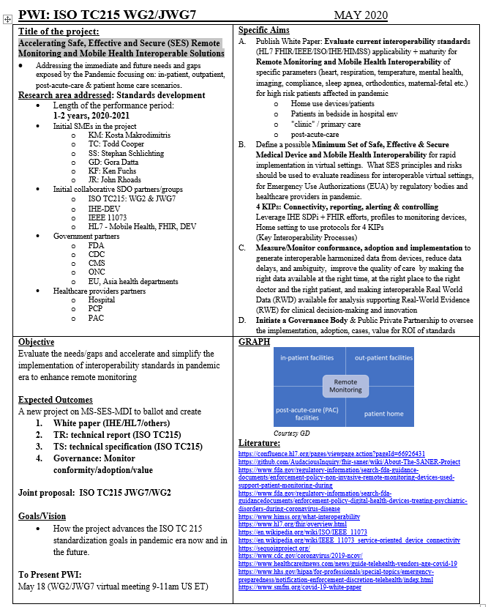
Accelerating Safe, Effective and Secure Remote Monitoring and Mobile Health Interoperable Solutions (QUAD-chart)
Title, team, partners
Objective, Outcomes
Aims
Graph, Literature

Slide 8
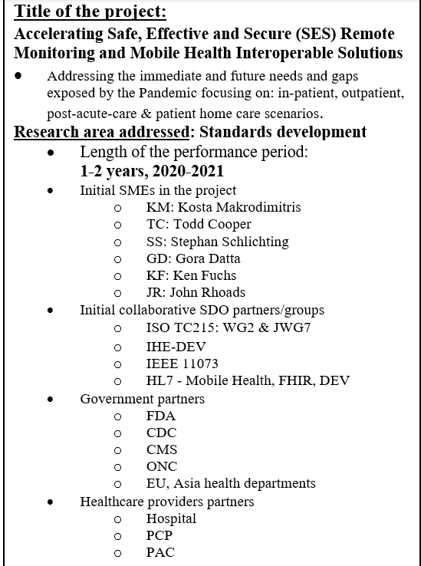
Accelerating Safe, Effective and Secure Remote Monitoring and Mobile Health Interoperable Solutions (QUAD-chart)
Title, team, partners
Objective, Outcomes
Aims
Graph, Literature

Slide 9
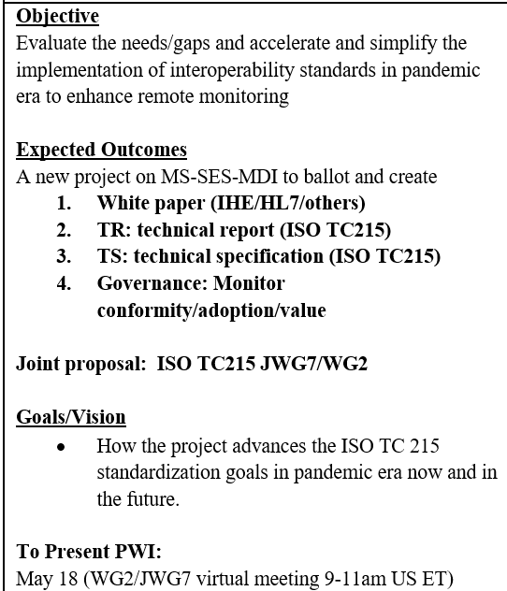
Accelerating Safe, Effective and Secure Remote Monitoring and Mobile Health Interoperable Solutions (QUAD-chart)
Title, team, partners
Objective, Outcomes
Aims
Graph, Literature

Slide 10
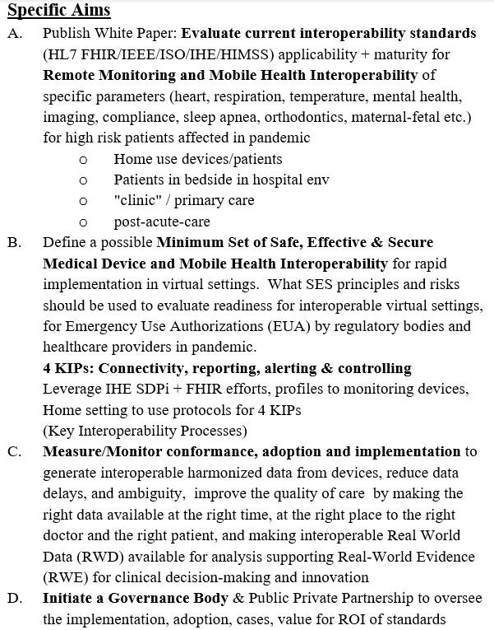
Accelerating Safe, Effective and Secure Remote Monitoring and Mobile Health Interoperable Solutions (QUAD-chart)
Title, team, partners
Objective, Outcomes
Aims
Graph, Literature

Slide 11
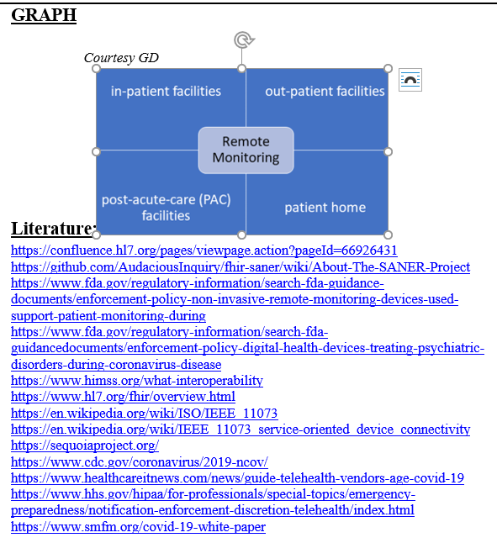
Accelerating Safe, Effective and Secure Remote Monitoring and Mobile Health Interoperable Solutions (QUAD-chart)
Title, team, partners
Objective, Outcomes
Aims
Graph, Literature

Slide 12
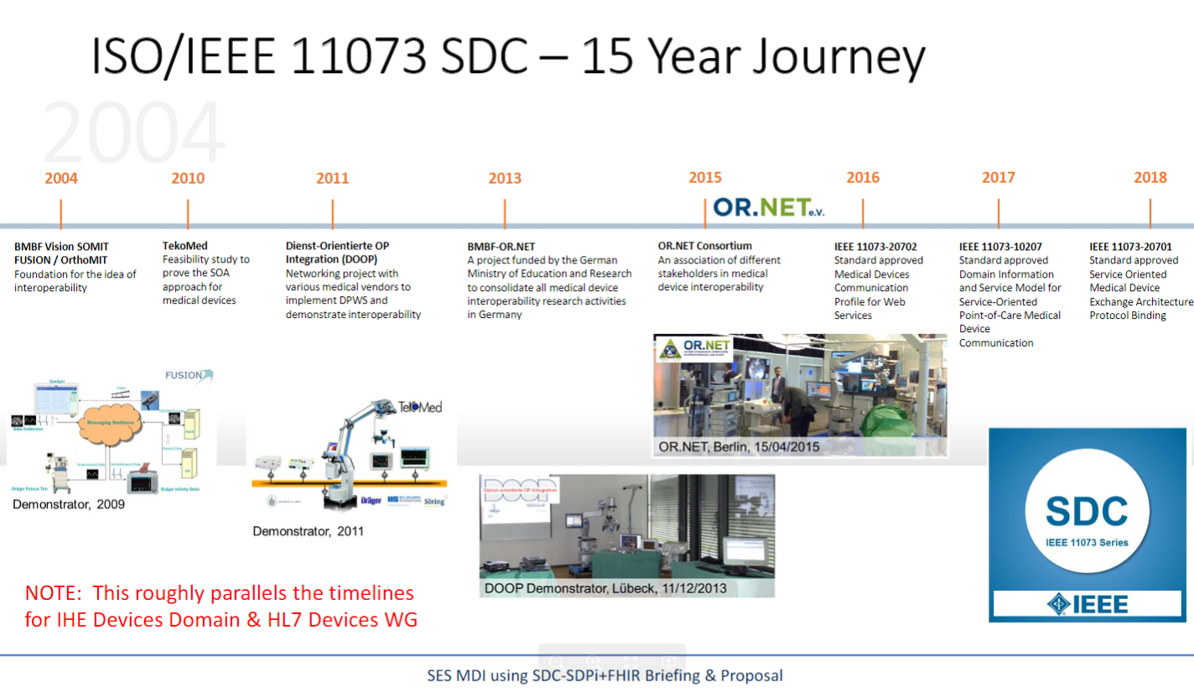
ISO/IEEE 11073 initiatives/standards
SDPi+FHIR Paper - SES MDI Created by Todd Cooper,

Slide 13
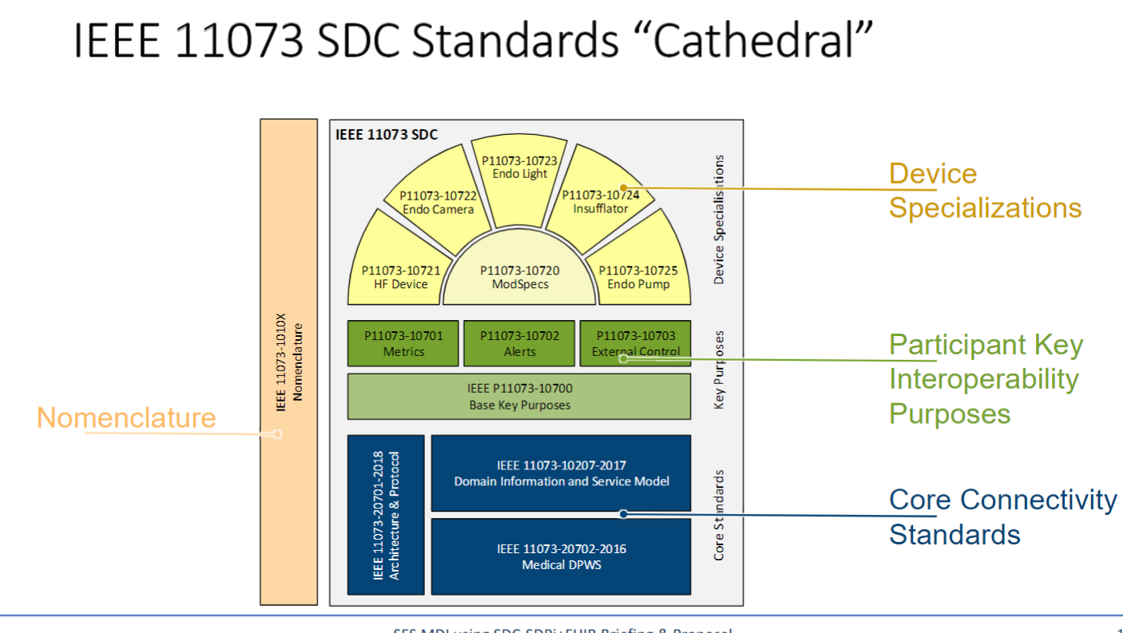
ISO/IEEE 11073 initiatives/standards
SDPi+FHIR Paper - SES MDI Created by Todd Cooper,

Slide 14
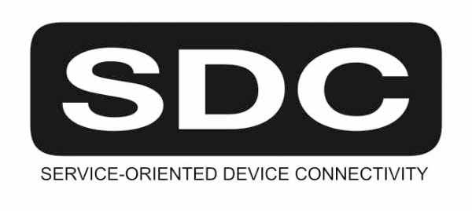
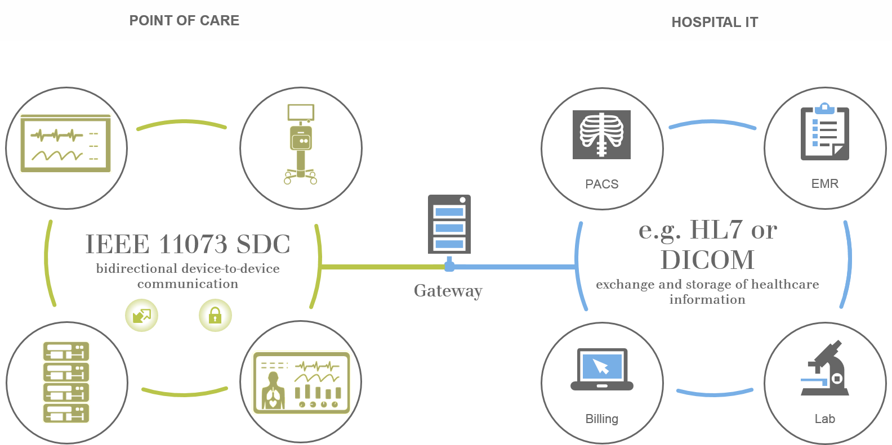
SDC Point-of-Care Context
HIT “Enterprise” Context
Device-to-Device
Plug-and-Play for
Reporting / Alerting & Controlling
(PRACtical Interoperability)

Slide 15
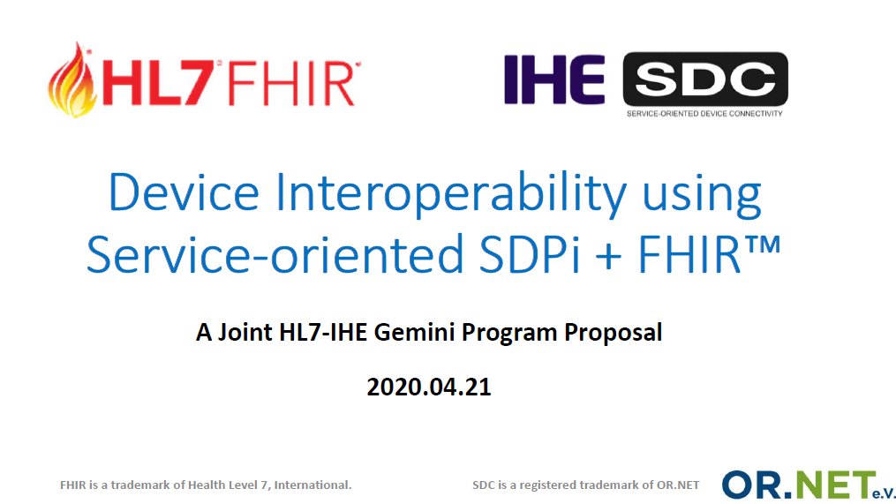
2020 Joint HL7-IHE Gemini Project
Full slide deck @ confluence.hl7.org “Device Interoperability using SDPi+FHIR” page

Slide 16
Gemini Project Deliverables & Governance
One set of cohesive, coordinated deliverables
IHE SDPi Supplement – published 2020 JUL, PAT/CAT testing Q3/4 ‘20
HL7 DoF IG supporting SDC integration & Alerting – ballot in 2020
DoF IG (proposed) for Device Information Consumers (title TBD)
Joint White Papers:
“What is a device?” - including AI/ML SAMD, across use context geographies
“Safe, Effective & Secure MDI Using SDC/SDPi + FHIR” – Quality / Regulatory / Legal Considerations
"Accelerating Safe, Effective and Secure Remote Monitoring and Mobile Health Interoperable Solutions“ – How do you know that a rapid response to address crisis (e.g., pandemic) challenges is safe enough, effective enough, and secure enough to allow for implementation & use?
Governance based on HL7 or IHE project home organization processes

Slide 17
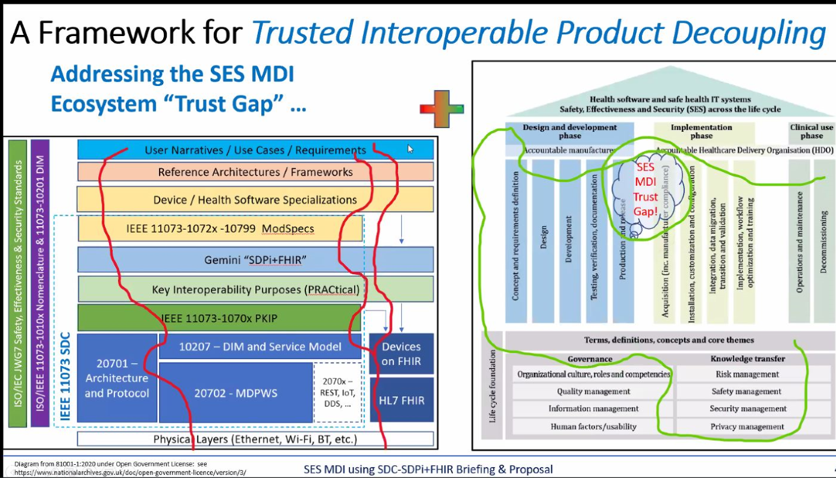

Slide 18
MOBILE HEALTH
Quality, efficacy, safety and security of mobile health apps
Gora DATTA, FHL7
LI: https://www.linkedin.com/in/goradatta/
TW: @goradatta

Slide 19
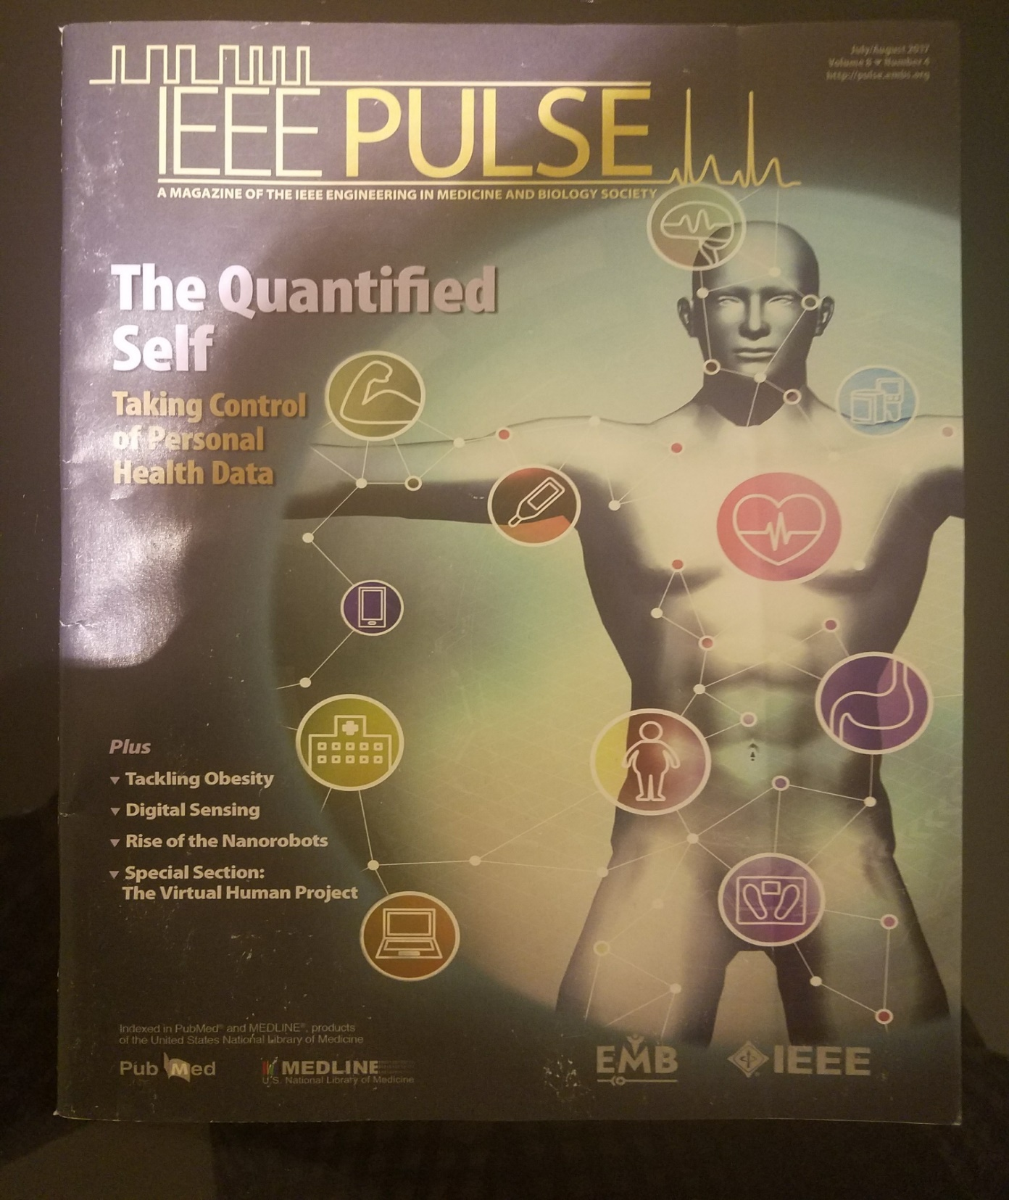
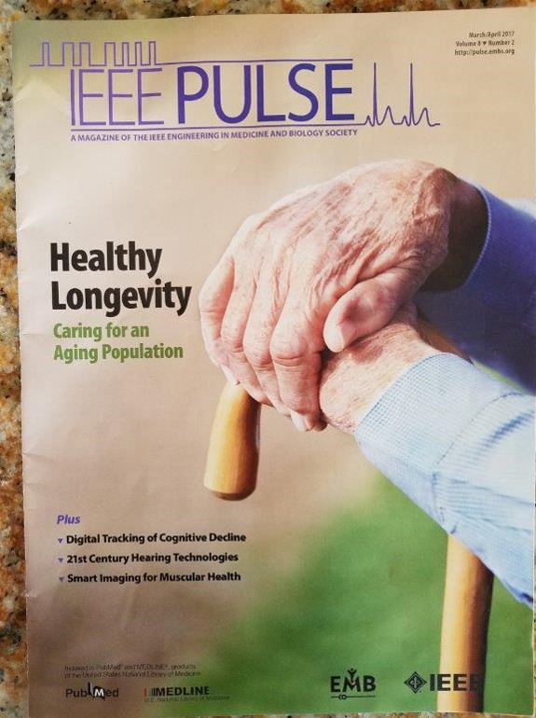
Notes:
The proliferation of Digital Health tools, including mobile health apps and wearable sensors, holds great promise for improving human health^{[1]}. The impact of Digital Health on patient care is accelerating with the increasing adoption of mobile health apps and wearable sensors. As per US-FDA: “The broad scope of digital health includes categories such as mobile health (mHealth), health information technology (IT), wearable devices, telehealth and telemedicine, and personalized medicine.”
^{[1]} https://www.fda.gov/medical-devices/digital-health

Slide 20
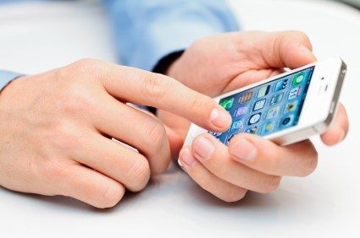





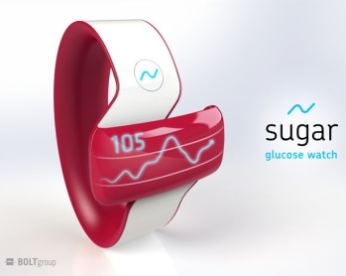

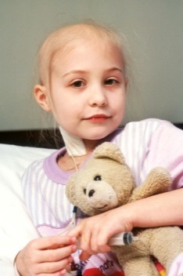
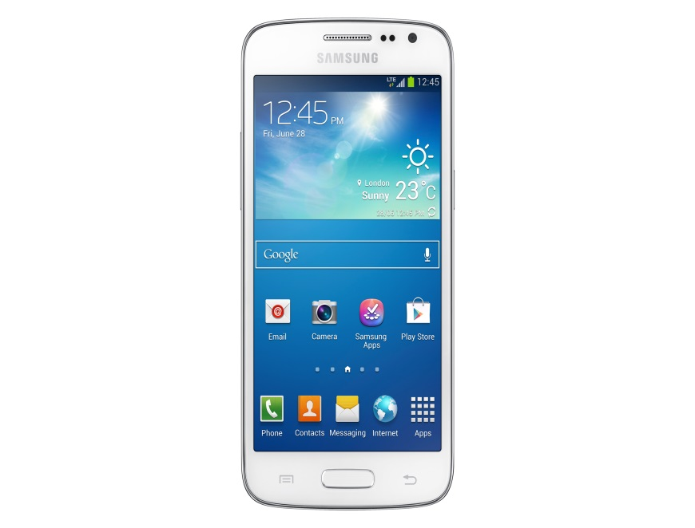


Mobile Health – Integrated Innovation
Engagement
Security
Privacy
Trust
Fitness
EHRs
Healthcare
Medications
Wearables
Secure
Safety
Patient Needs
Innovation
Efficiency
Guidelines
Best Practices
Care Providers
©Copyright HL7®
Notes:
It is envisaged that soon clinicians will be prescribing mobile health apps to patients, similar prescribing medicines or medical devices^{[2]}.
Mobile health apps have access to highly detailed, personally identifiable and clinical information about end-users. Security and privacy are big issues, raising questions about permission control and confidentiality, as well as the integrity of the infrastructure and the individual. There is also a need to clarify how to ensure practicalities of data storage and management, availability and maintenance of the network, as well as compatibility and interoperability. ^{[3]} Another aspect that is critical for mobile health app usage, by both patients and healthcare providers, is the impact of cyber security on these apps^{[4]}.
^{[2]} https://www.medicaleconomics.com/news/finding-mobile-health-apps-work-doctors-and-patients
^{[3]} https://www.himss.eu/himss-taxonomy-topics/mhealth?page=1
^{[4]} https://www.nccoe.nist.gov/news/security-recommendations-mobile-health-apps

Slide 21
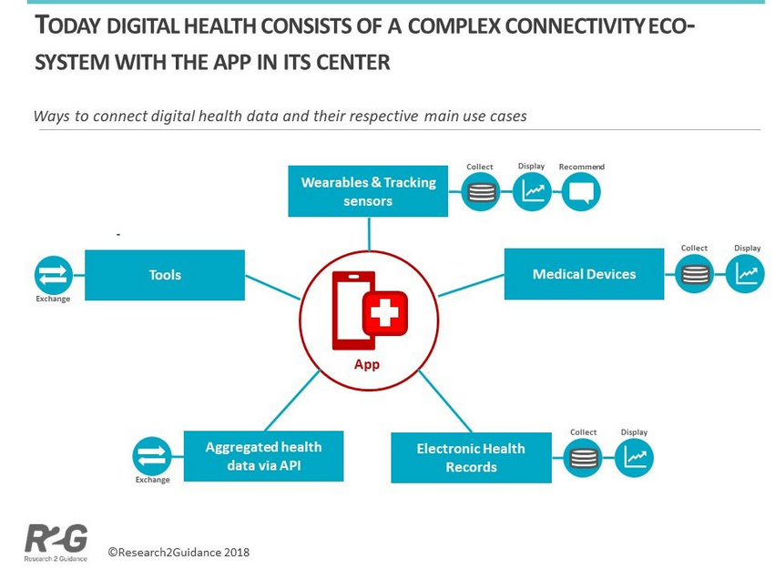
APP CENTRIC VIEW OF THE WORLD
Notes:
However, before this becomes as common as prescribing a medicine or a medical device by a provider, the mobile health app needs to safe/secure/accurate not only for the individual user/patient/family member but also for the clinician/payer/provider/regulatory community. Given the era of cybersecurity and its impact on healthcare^{[5]}, it is critical that the healthcare informatics standards community looks into this matter now.
^{[5]} https://healthinformatics.uic.edu/blog/cybersecurity-how-can-it-be-improved-in-health-care/

Slide 22
REFLECTION TIME!
There are between 400,000 to 500,000 health & fitness apps (Jan 2019)
There are over 325,000 mobile health apps (Apr 2018)
There are over 165,000 mobile health apps (2017)
There are over 150,000 mobile health apps (2015-16)
There are over 50,000 mobile health apps (2013-14)

Slide 23
What is driving this phenomenal growth?
KEY DRIVERS
Increasing global population
Aging population (not only a Developed world issue)
Higher Life Expectancy (people living longer)
Increasing Chronic diseases*: e.g., diabetes, obesity, heart disease etc.
Technological advances
Emergence of Personalized medicine
Global reach of diseases
[Chronic Disease is a long-lasting condition that can be controlled but not cured]
© credit: Gora Datta

Slide 24
Mobile Health Scenarios
Caregiver on the move
Hospitals, Clinics, Long term care, Hospice
Patient empowerment
Patient involvement in care process across a wide range of lifestyles, including: support for long term conditions
Independent living
Assisted living drawing on a range of mobile services
Behavioral health
Behavioral health support anytime, anywhere
Messaging (ranging from unsecure to secure)
Bridging the health divide
Public/Population Health
Disaster Management to PH outreach

Slide 25
REMOTE MOBILE HEALTH
(Hospitals)
(PCPs)
(nursing homes: SNFs)
© credit: Gora Datta

Slide 26
COMING SOON-Mobile Health!
Prescribing Mobile Health Apps
UHAI: Unique Health App Identifier! (UDI for Mobile Health Apps)
Mobile Health Apps Conformity Assessment, Certification Guidance
Notes:
ISO/TC215 WG1&WG2 is in the midst of proposing a NWIP on “Mobile Health Apps Conformity Assessment & Certification Guidance” Technical Specification. The proposed TS is based upon (1) HL7 cMHAFF STU & (2) ISO/TC215 82304-2 TS.

Slide 27
THANK YOU!

